Slide 1
BUAN 6356 Movie Analytics using R
Presented by Group 11

Slide 2

Data Column | Description
id | ID number given to each movie
title | Title of the movie
CountryofProduction | Country that the movie was produced in
release_date | Date of release
Director | Name of movie director
Actor_1 | Name of lead actor
Actor_2 | Name of second lead actor
SocialMedia_likes | Facebook or Twitter likes of the actor
Budget | Budget used for the movie in USD
Revenue | Revenue earned by the movie in USD
Imdb_score | Score given to the movie by imdb users
Meta_score | Score given to the movie by movie critics
Vote_count | Count of imdb users that rated the movie
Runtime | Duration of the movie in minutes
Language ID | Language that the movie was produced in
Genre | Three columns that describe the genre of the movie
Keyword | Five columns depicting key words used in the movies
Studio | Three columns with studio names that produced the movie
Status | Status of the movie whether released or in production
Tagline | A statement used during promotion of the movie during marketing
Description of dataset
There are a total of 3085 movies considered for analysis
Range of data – the movies span from 1916 to 2016
We have a total of 28 columns describing the movies
Data Pre-Processing
Performed data cleaning activities on : budget, imdb score, actor social media likes, vote count, runtime
We will walk through the analysis done for :
IMDB ratings Vs important aspect of movies (Actor, Director, Studio)
Profitability – IMDB score, budget, genre and profitable associations
Factors determining success – using decision trees
Trends over time
Sentiment analysis and text mining

Slide 3
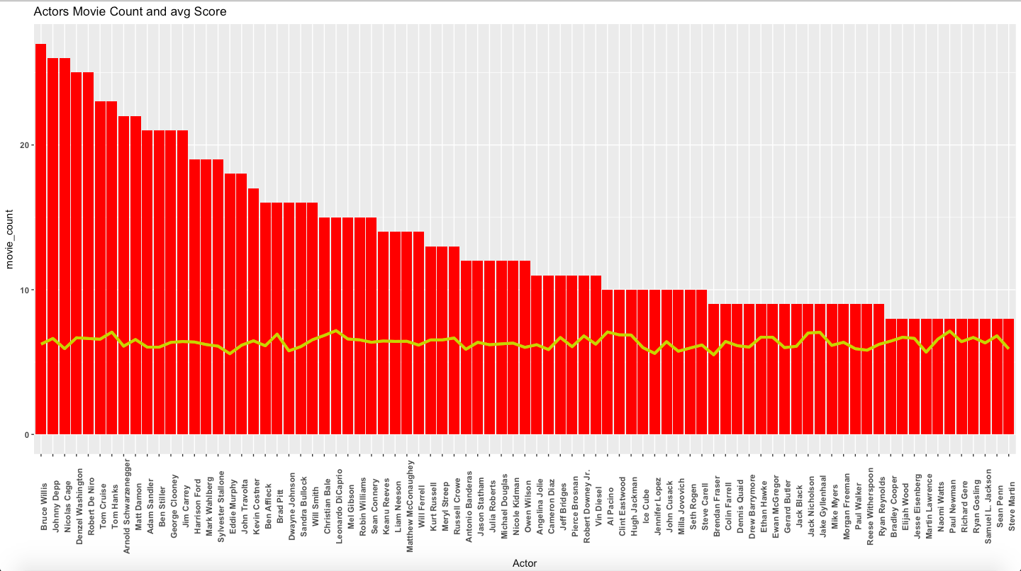
Leonardo DiCaprio tops the list with an average IMDB score of 7.17
Notes:
Amongst Directors who have produced more than 8 movies in our dataset Christopher Nolan stands out. He has the highest ratings as compared to the other directors. Steven Spielberg is the director for most number of movies.
NOTE_ Add descriptive table
Leonardo Dicaprio is the most highly rated actor
NOTE _ Add the descriptive table and order by count of movies done

Slide 4
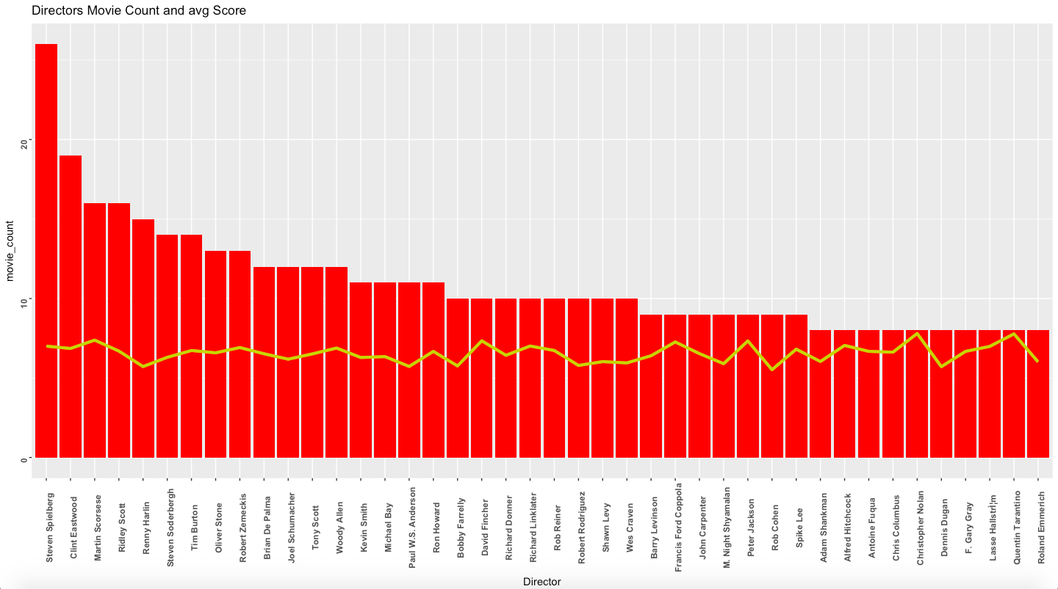
Stephen Spielberg has a movie count of 26 movies but also an IMDB score of 7.00
Christopher Nolan tops the list with the average score of 7.8
Notes:
bold

Slide 5
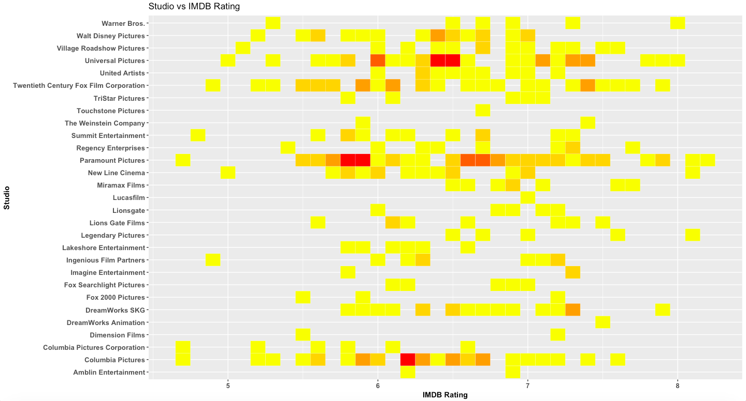
The Prestige
To Kill a Mocking Bird
Mission Impossible 3, The Longest Yard & The Adventures of Tintin
Inception
Notes:
Make the wordings bolder

Slide 6

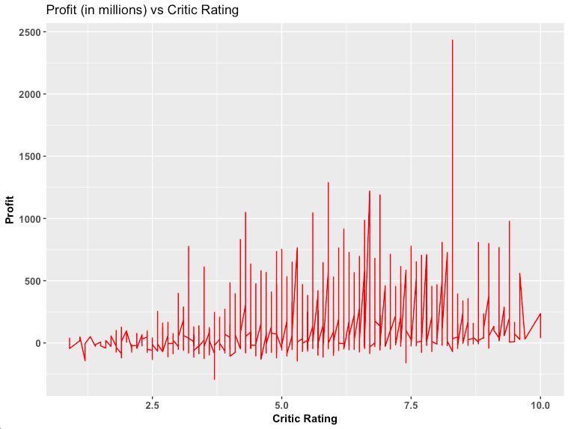
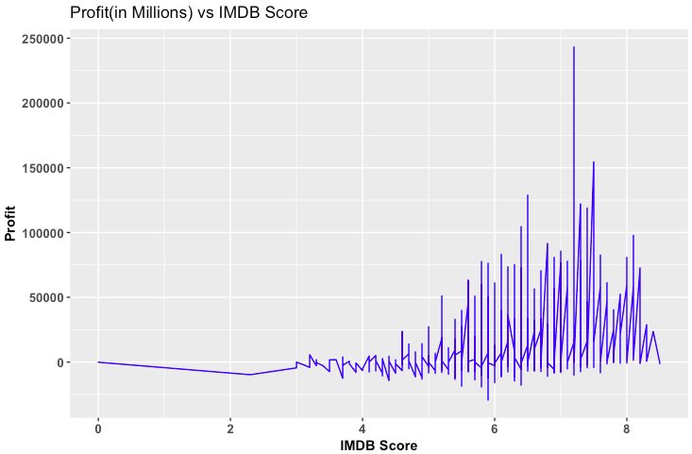
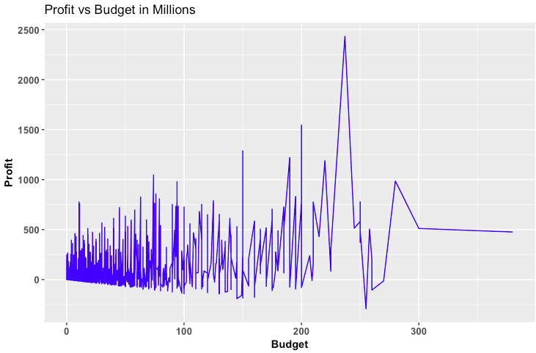
Rating
3.2 - Transformers: Age of Extinction
8.8 - Inside Job
8.2 - 127 Hours
Avatar
Avatar Titanic
Pirates of the Caribbean: On Stranger Tides,
Avengers: Age of Ultron
Notes:
For IMDB Scores we can say that movies rated around 7 are the most profitable movies.
Highly rated movies seem to be less profitable in comparison to those that are rated around 7.
We can see that in general the profit increases with an increase in budget up to one point after which it becomes stagnant.
NOTE _ make it more colourful
Find examples

Slide 7

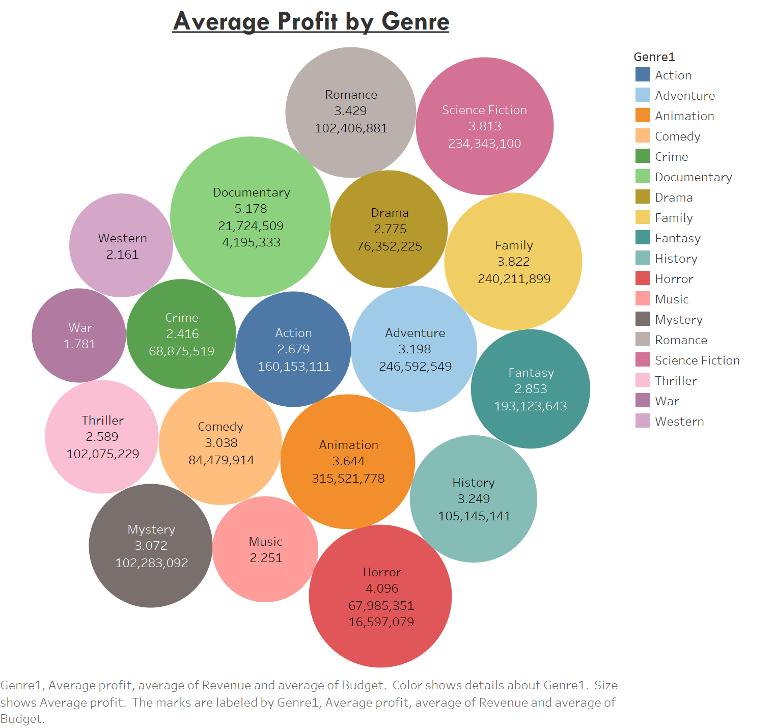
Notes:
Profit=revenue/budget. To eliminate the inflation of budget and profit over the years. Although documentaries is a very small genre they seem to make a high average profit ratio of 5.178 may be by selling rights to television and other streaming services in the recent years. Other high average profit genres are horror=4.096, Science fiction, romance, action and mystery. We notice a trend of genres using animation and vfx technologies making good profit overall

Slide 8
DIRECTOR | ACTOR | MOVIE | DIRECTOR | ACTOR | MOVIE
Dennis Dugan | Adam Sandler | Happy Gilmore | Tim Burton | Johnny Depp | Charlie and the Chocolate Factory
 |  | Just Go with It |  |  | Dark Shadows
 |  | Big Daddy |  |  | Edward Scissorhands
 |  | Grown Ups |  |  | Corpse Bride
 |  | Grown Ups 2 | Ron Howard | Tom Hanks | Angels & Demons
 |  | You Don't Mess with the Zohan |  |  | Apollo 13
 |  | Jack and Jill |  |  | The Da Vinci Code
Adam McKay | Will Ferrell | Anchorman: The Legend of Ron Burgundy |  |  | Splash
 |  | Step Brothers | Tony Scott | Denzel Washington | Man on Fire
 |  | Talladega Nights: The Ballad of Ricky Bobby |  |  | Crimson Tide
 |  | The Other Guys |  |  | Unstoppable
 |  | Anchorman 2: The Legend Continues |  |  | The Taking of Pelham 1 2 3
Wes Craven | David Arquette | Scream | Martin Scorsese | Robert De Niro | GoodFellas
 |  | Scream 2 |  |  | Taxi Driver
 |  | Scream 3 |  |  | Cape Fear
 |  | Scream 4 |  |  | Casino
Paul W.S. Anderson | Milla Jovovich | Resident Evil | Martin Scorsese | Leonardo DiCaprio | The Wolf of Wall Street
 |  | Resident Evil: Retribution |  |  | Shutter Island
 |  | Resident Evil: Afterlife |  |  | The Departed
 |  | The Three Musketeers |  |  | Gangs of New York
Gore Verbinski | Johnny Depp | Pirates of the Caribbean: Dead Man's Chest | Steven Soderbergh | George Clooney | Ocean's Eleven
 |  | Pirates of the Caribbean: The Curse of the Black Pearl |  |  | Ocean's Thirteen
 |  | Pirates of the Caribbean: At World's End |  |  | Out of Sight
 |  | Rango |  |  | Ocean's Twelve
 |  |  | Steven Spielberg | Harrison Ford | Raiders of the Lost Ark
 |  |  |  |  | Indiana Jones and the Last Crusade
 |  |  |  |  | Indiana Jones and the Temple of Doom
 |  |  |  |  | Indiana Jones and the Kingdom of the Crystal Skull
Minimum Support: 0.005
Minimum
Confidence: 0.2
Notes:
Association rules btw actors and directors which leads to profitability.

Slide 9
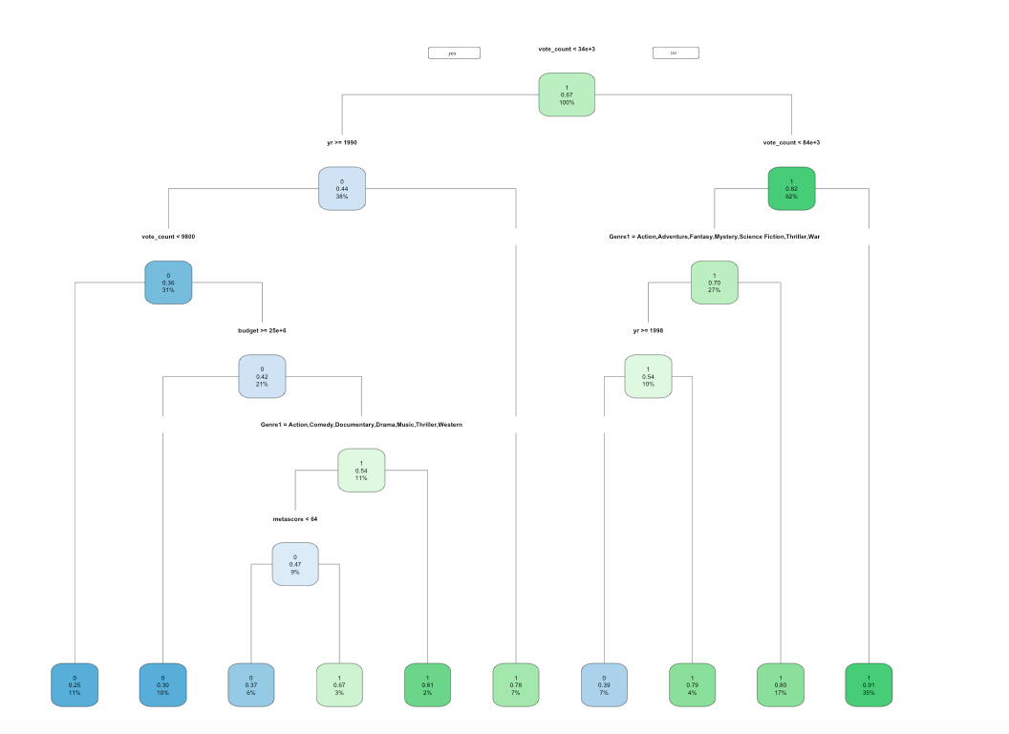
Accuracy:
Train – 80%
Test – 76%
Vote Count
Vote Count
Sing(2016)
Genre:
Animation
Vote count:
83,126
Budget:
75 million
Box Office:
634.3 million
Year
Genre
Vote Count
Budget
Year
Genre
Metascore
Notes:
Add stats

Slide 10
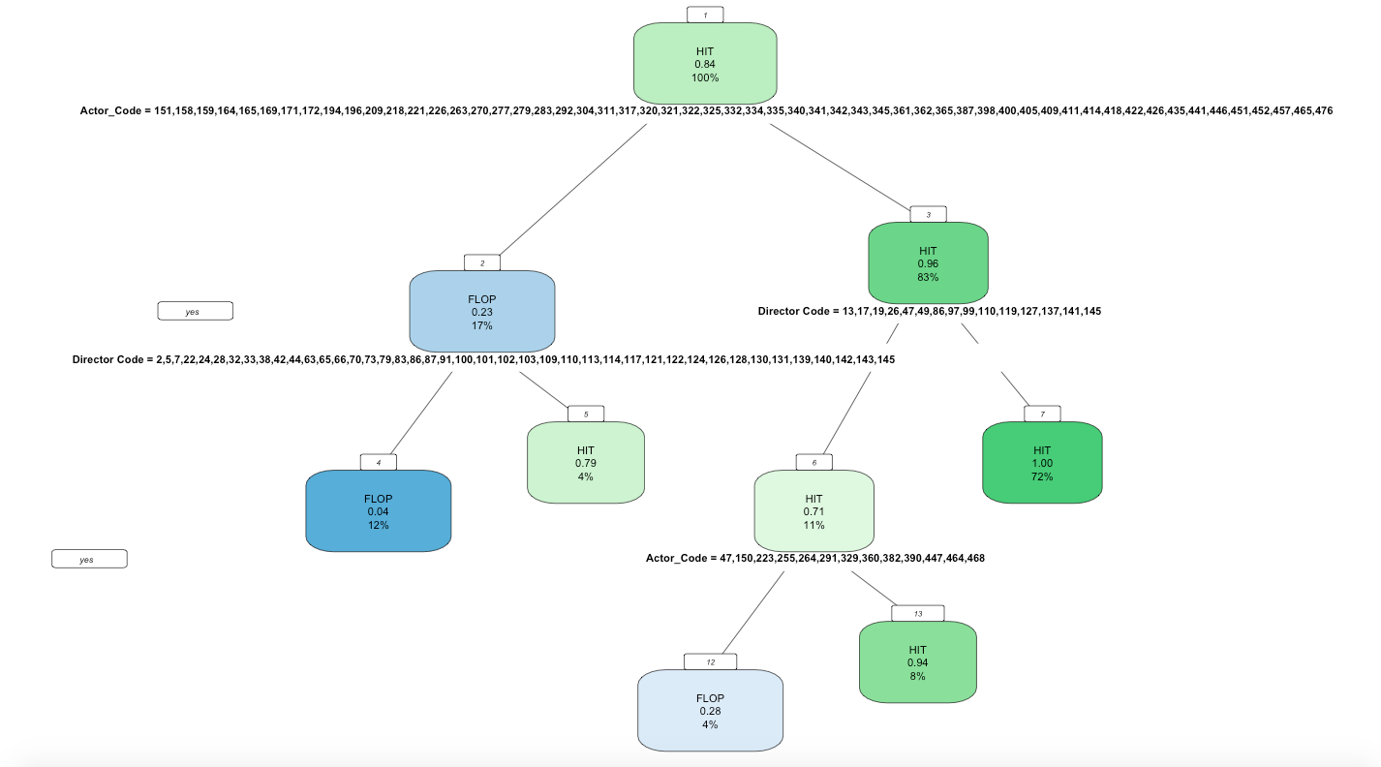
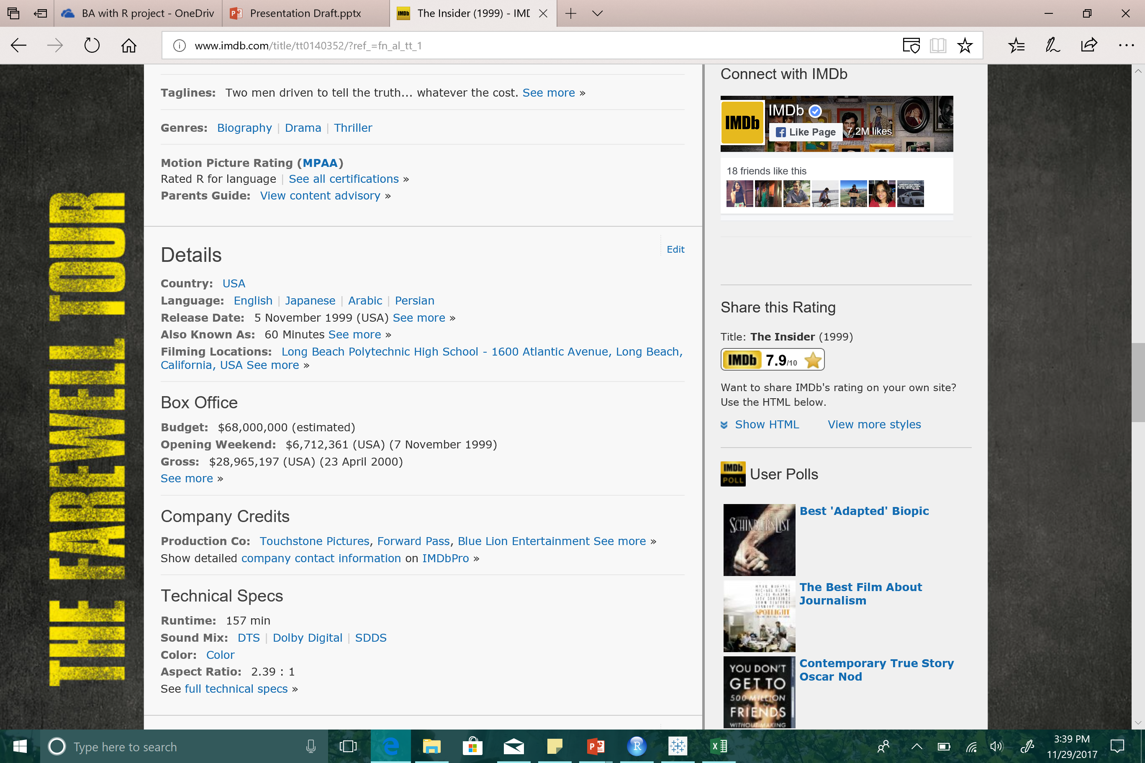
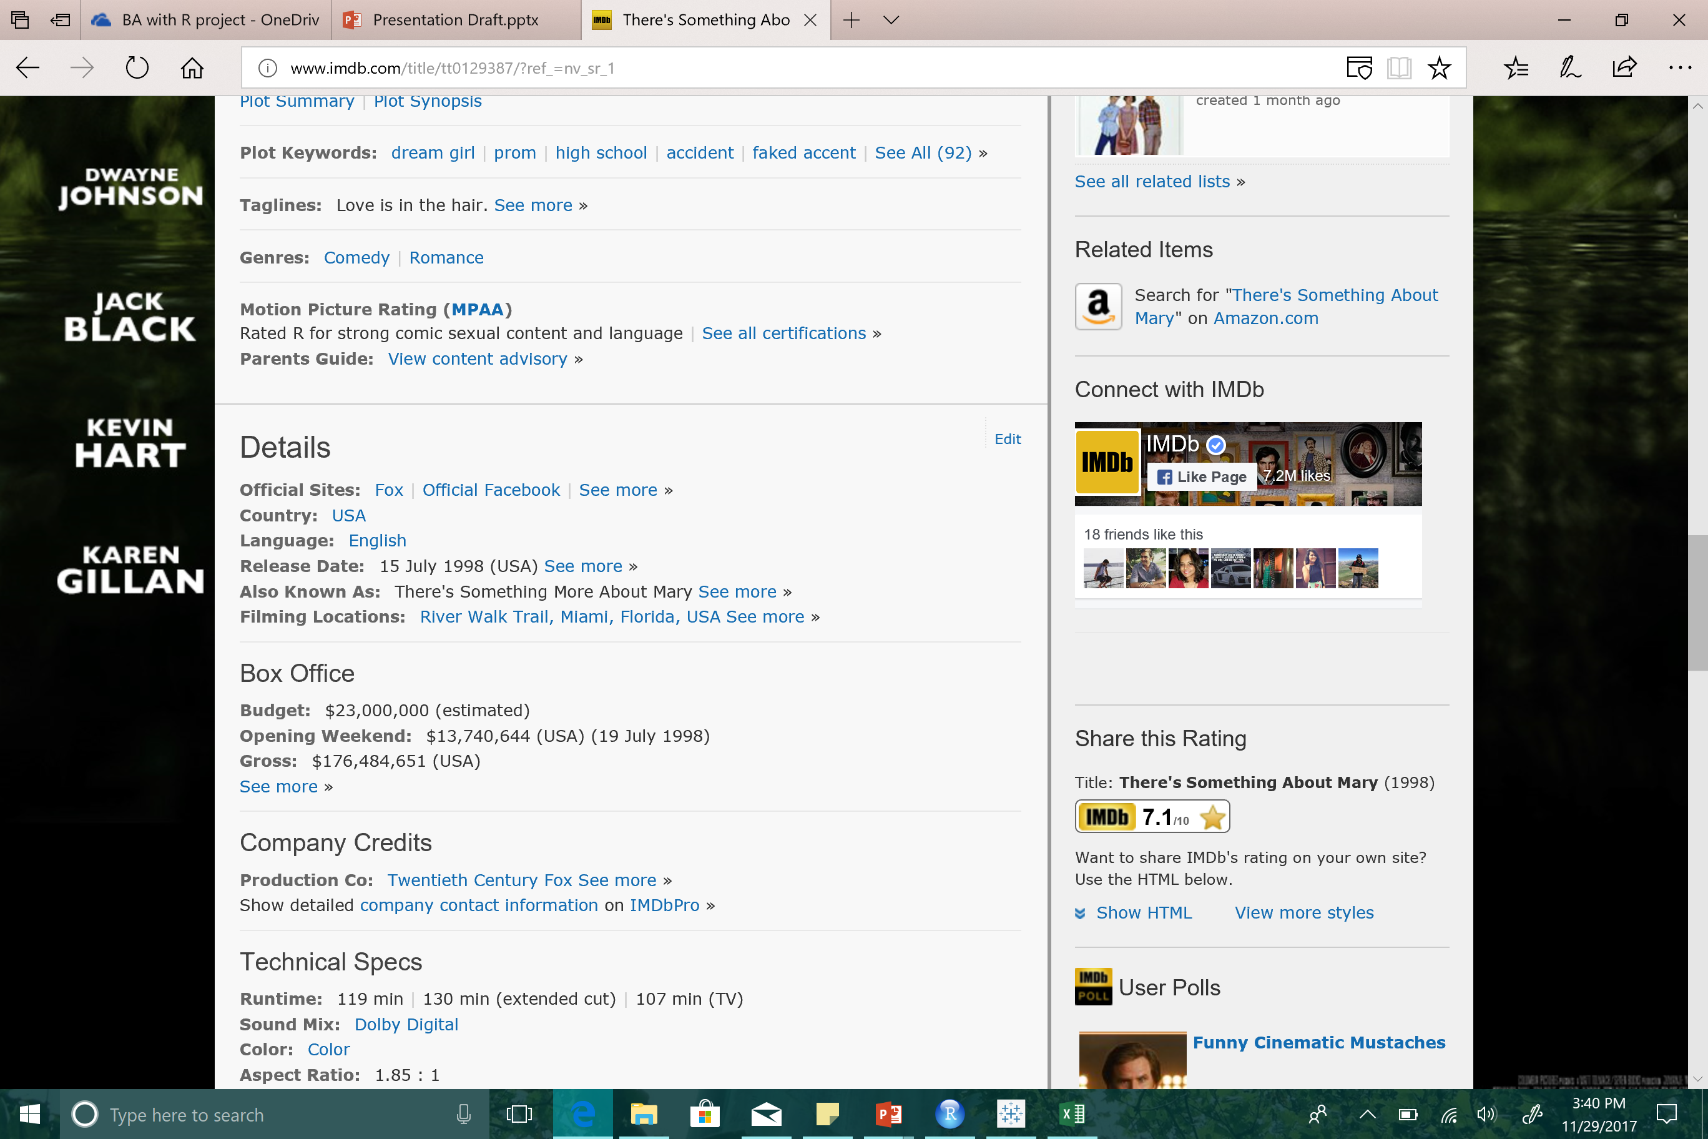
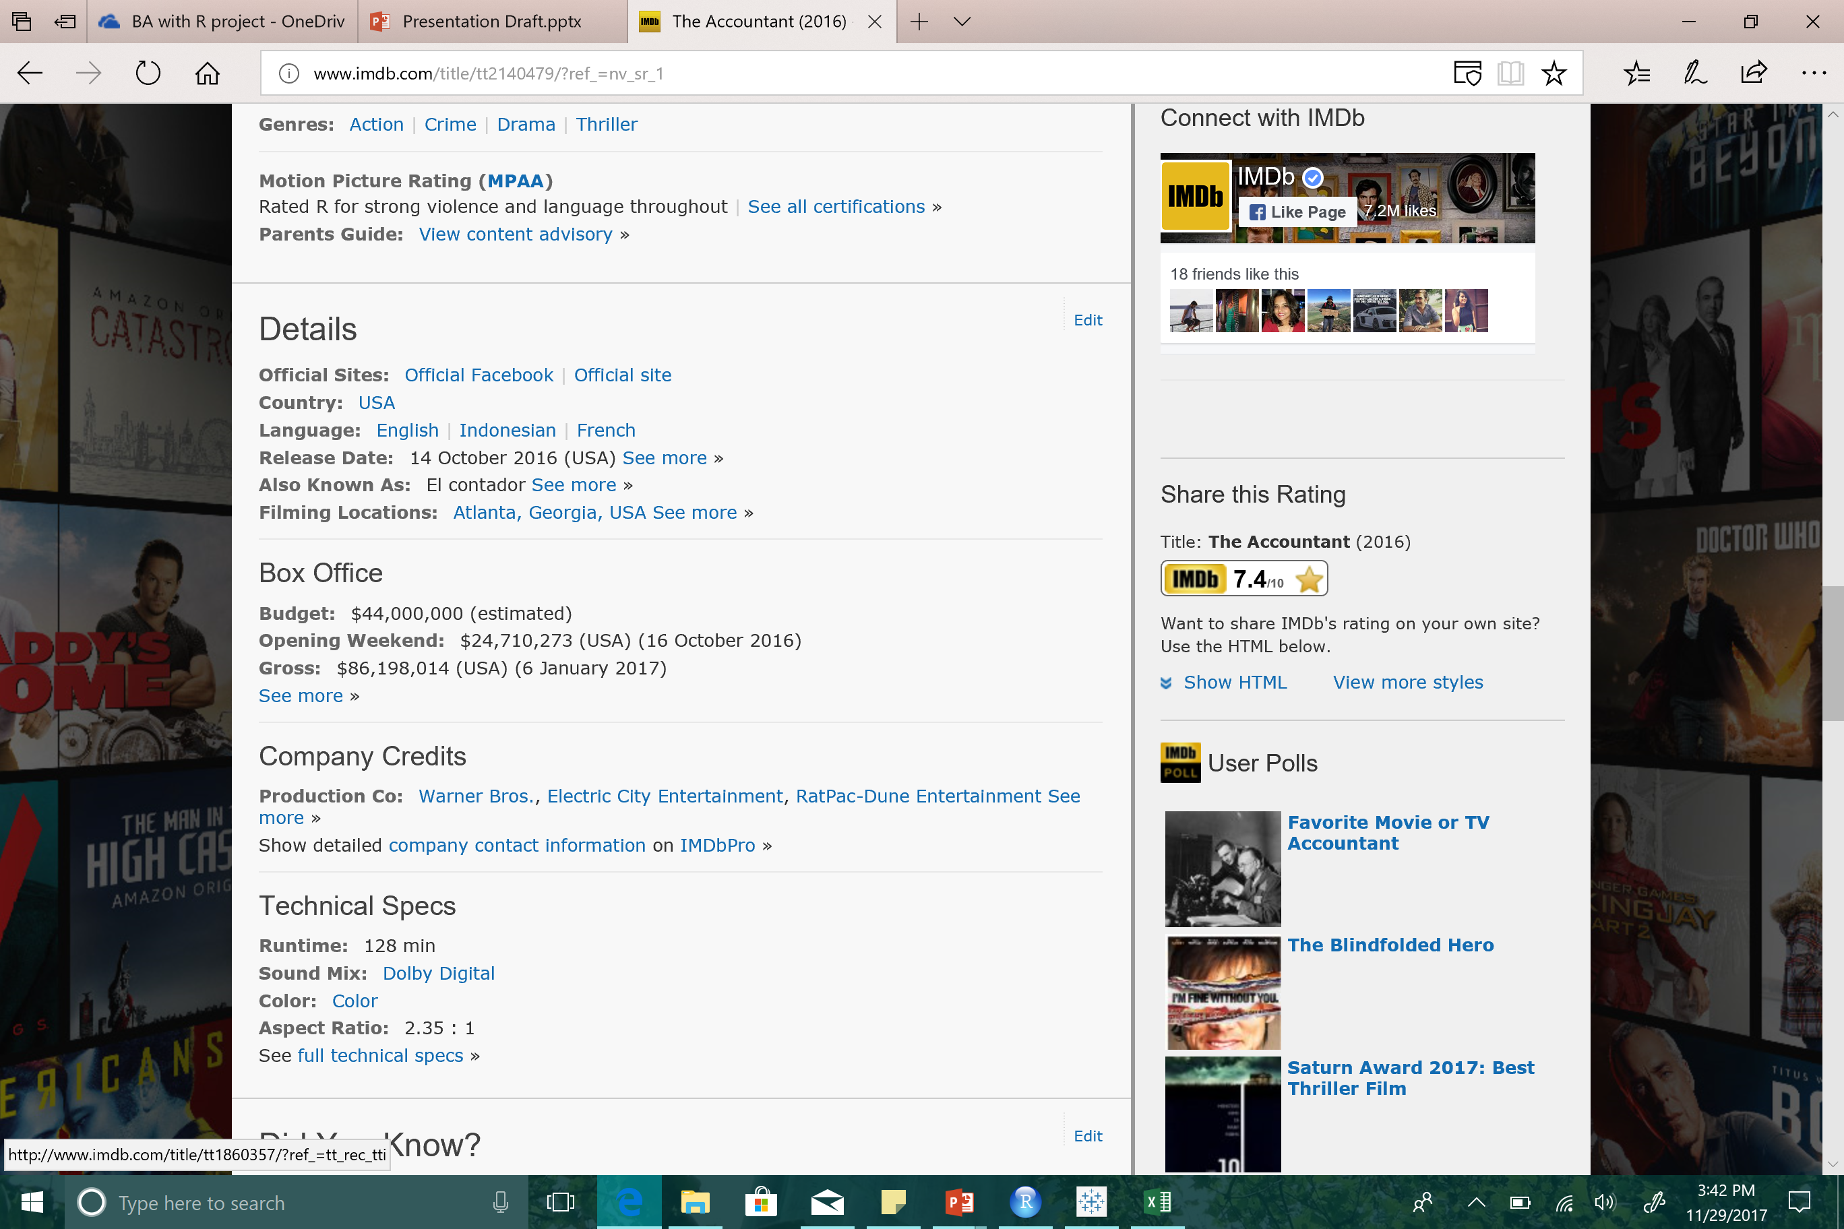
Decision Tree – Actor/Director
Dataset | % of the Total Data | Accuracy | Errorrate
Train | 60 | 96.9 | 3.1
Test | 40 | 84.14 | 15.86
Title | Director | Director Code | Actor | ActorCode
The Insider | Michael Mann | 91 | Al Pacino | 151
Title | Director | Director Code | Actor | ActorCode
The Accountant | Gavin O Connor | 45 | Ben Affleck | 169
Title | Director | Director Code | Actor | ActorCode
There is Something about Mary | Bobby Farrely | 13 | Cameron Diaz | 186
The Insider
There is Something about Mary
The Accountant
Notes:
Lets try some examples:
False +ve Rates: 40%
Fale –ve Rates: 11.6%

Slide 11

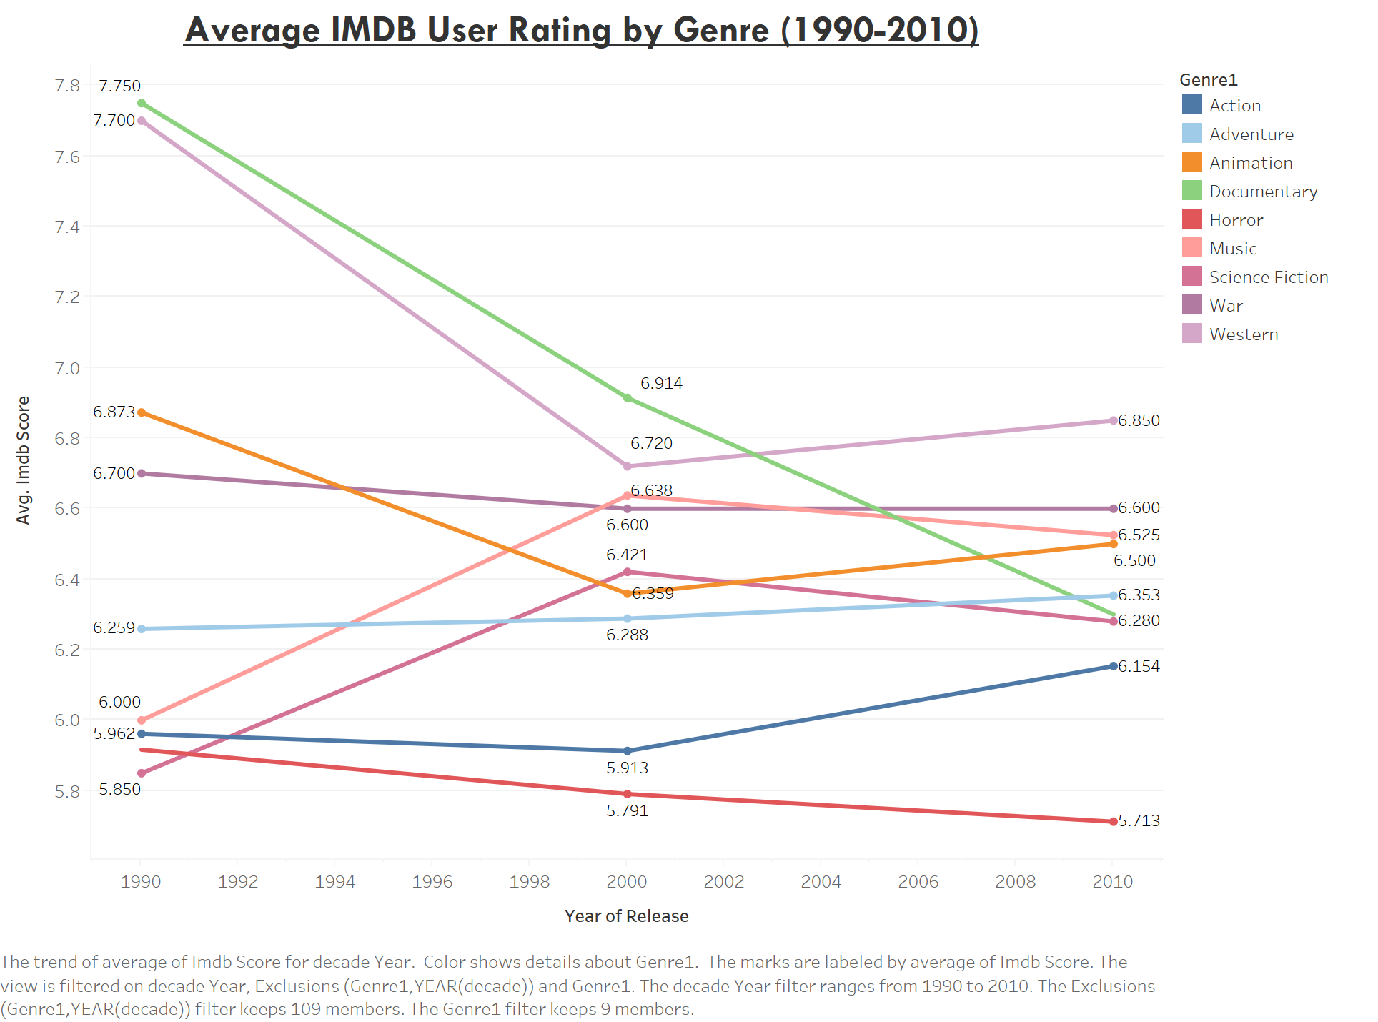
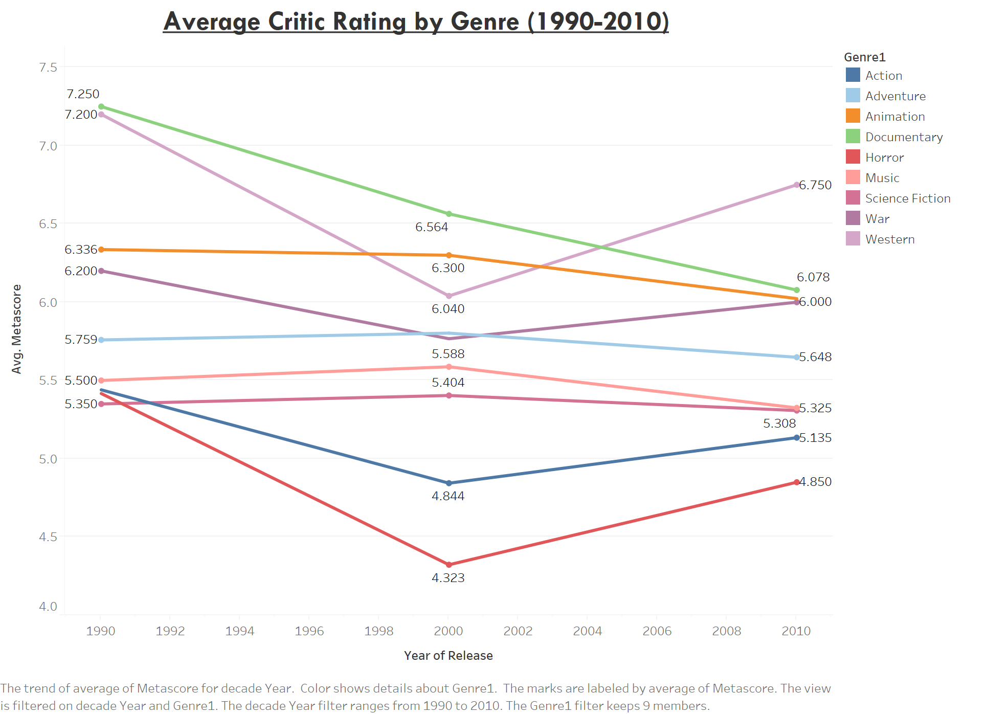
Similar User and Critic Rating – Documentary, Western
User Favorite- Sci-fi, Action, Adventure & Music
Notes:
Shows how the genre rating has changed over the years. Documentaries like Roger & me (General motors), Beyond the mat (wrestling) are all time favorites and critically acclaimed documentaries. Western classic & actions like the unforgiven, open range are highly rated by both critics and users
We see critics and users have similar ratings for documentaries, western classics, comedy and family movies. However we see a change in trend where users highly rate action, adventure, horror, animation, music movies.
The popularity of adventure, action and animation and si-fi movies seem to have increased after 2000 and all of these are animation &vfx categories.
The popularity of music genre leads us to looking at actor popularity on social media. The top 20 popular actors have 7 singers and also actors like chris pratt who gained popularity in small screen and dwayne Johnson who gained popularity in wrestling.
So we look top grossing movies and actor popularity
Si-fi movies in star wars, star trek, transformer movies are user favorites while critics disagree and same with musical movies like step up

Slide 12
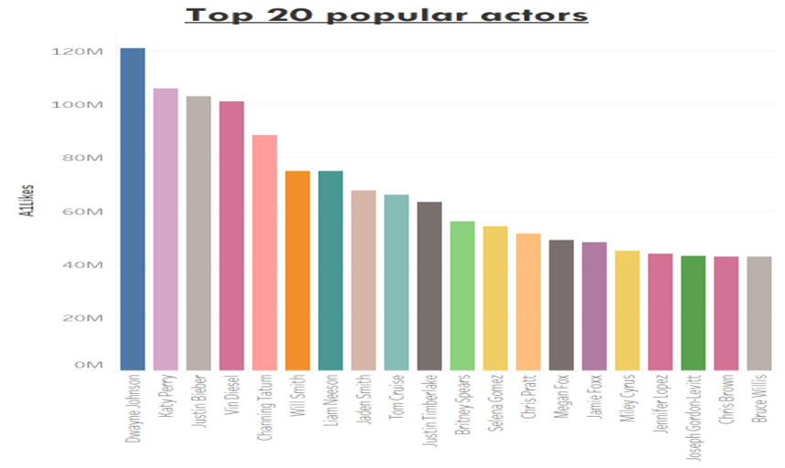
Similar User and Critic Rating – Documentary, Western
User Favorite- Si-fi, Action, Adventure & Music
Notes:
Shows how the genre rating has changed over the years. Documentaries like Roger & me (General motors), Beyond the mat (wrestling) are all time favorites and critically acclaimed documentaries. Western classic & actions like the unforgiven, open range are highly rated by both critics and users
We see critics and users have similar ratings for documentaries, western classics, comedy and family movies. However we see a change in trend where users highly rate action, adventure, horror, animation, music movies.
The popularity of adventure, action and animation and si-fi movies seem to have increased after 2000 and all of these are animation &vfx categories.
The popularity of music genre leads us to looking at actor popularity on social media. The top 20 popular actors have 7 singers and also actors like chris pratt who gained popularity in small screen and dwayne Johnson who gained popularity in wrestling.
So we look top grossing movies and actor popularity
Si-fi movies in star wars, star trek, transformer movies are user favorites while critics disagree and same with musical movies like step up

Slide 13
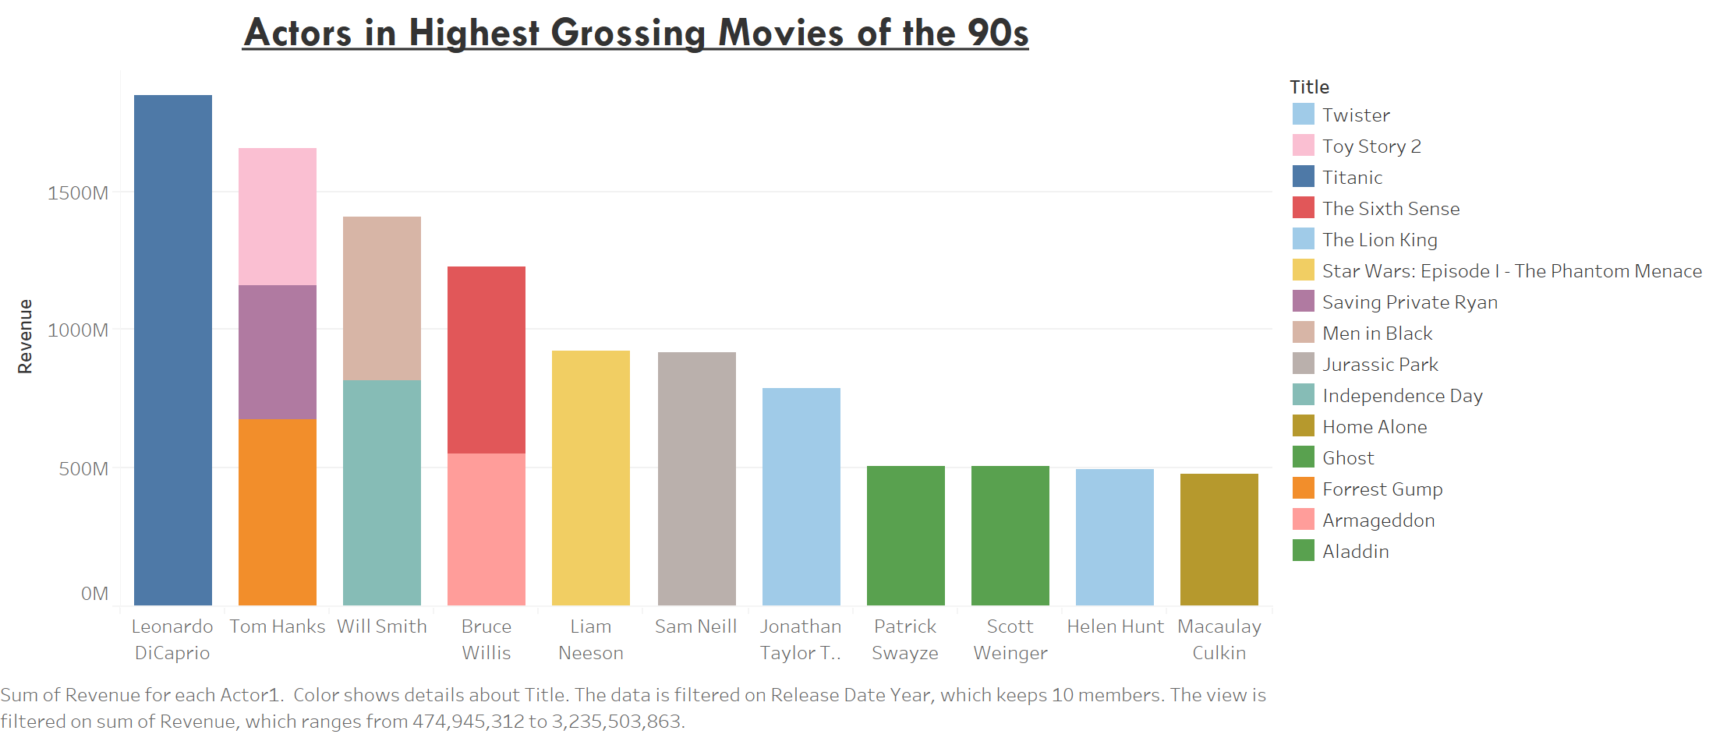
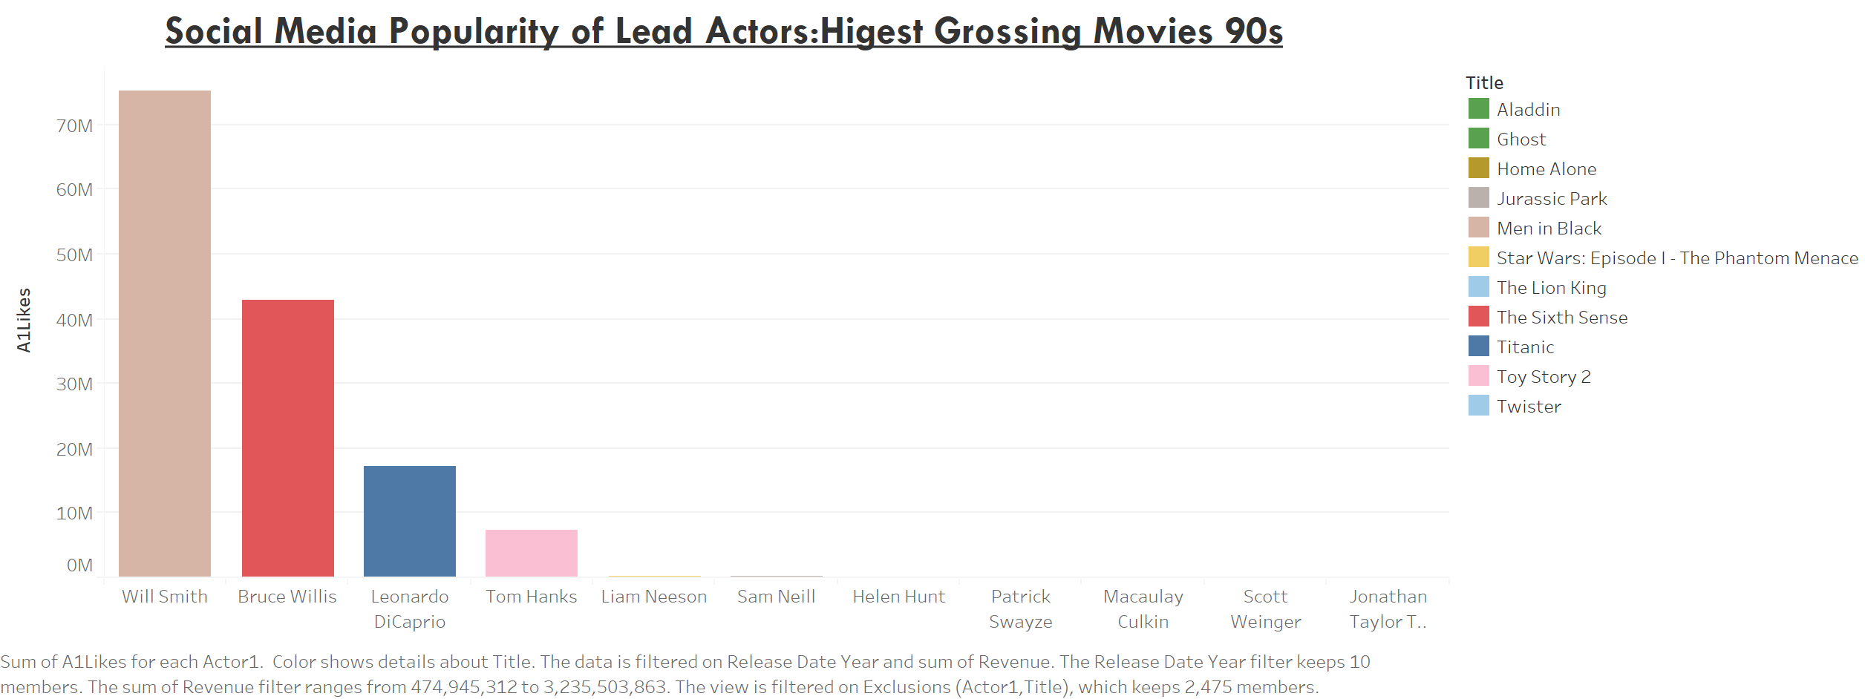
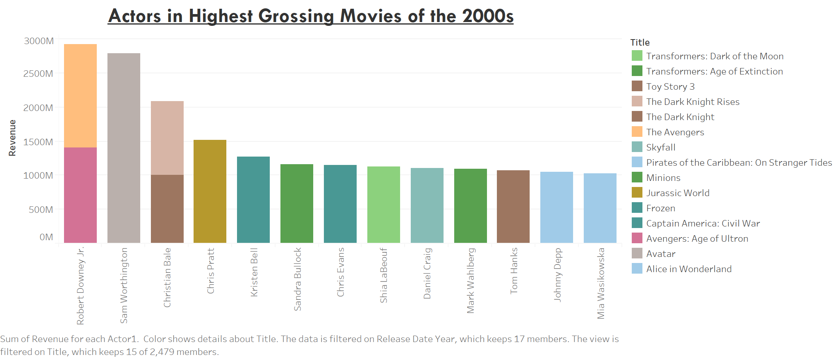
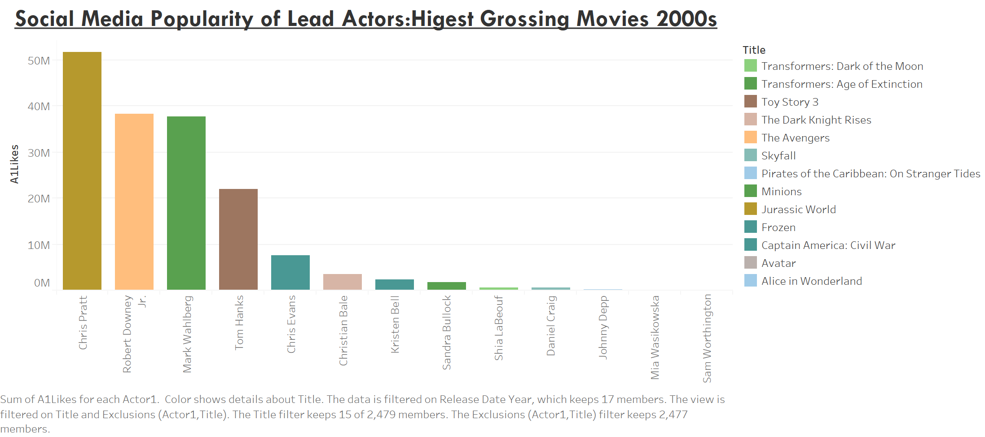
Notes:
Look at actors who are highly popular and then the count of movies and then the revenue

Slide 14

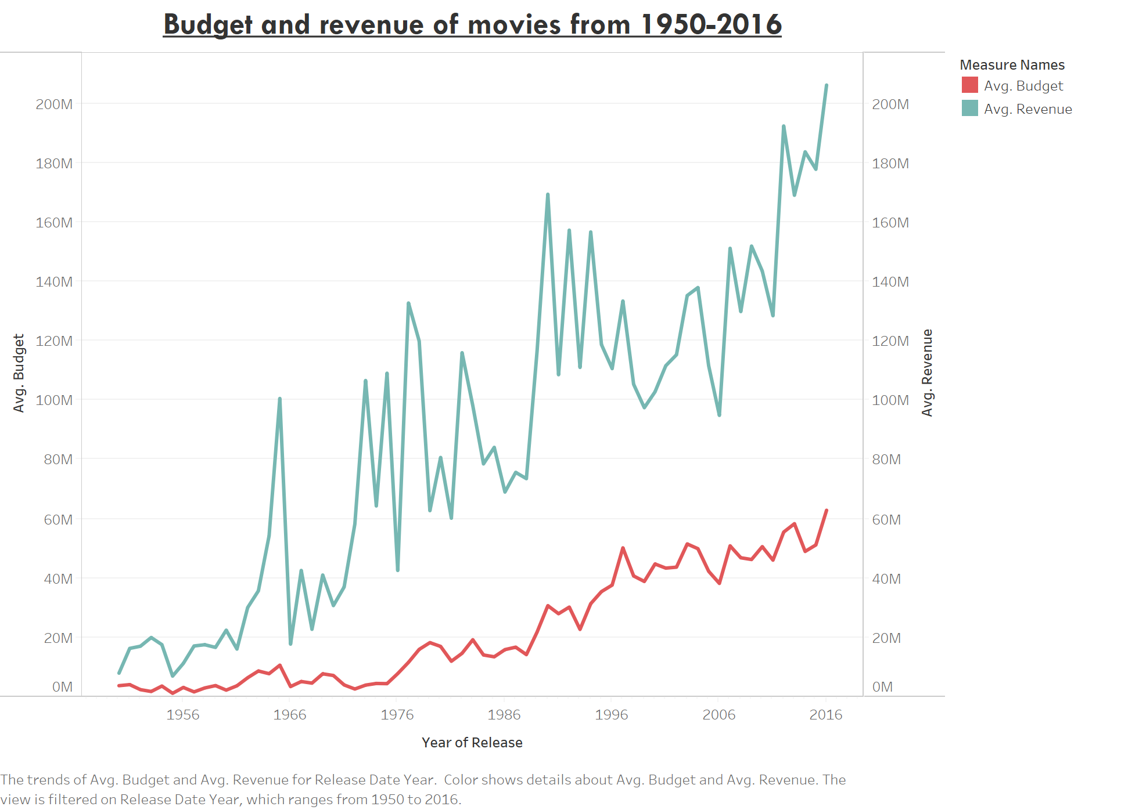
Notes:
Taking inflation into consideration we can see that the average amount invested in movies has increased a little over time

Slide 15
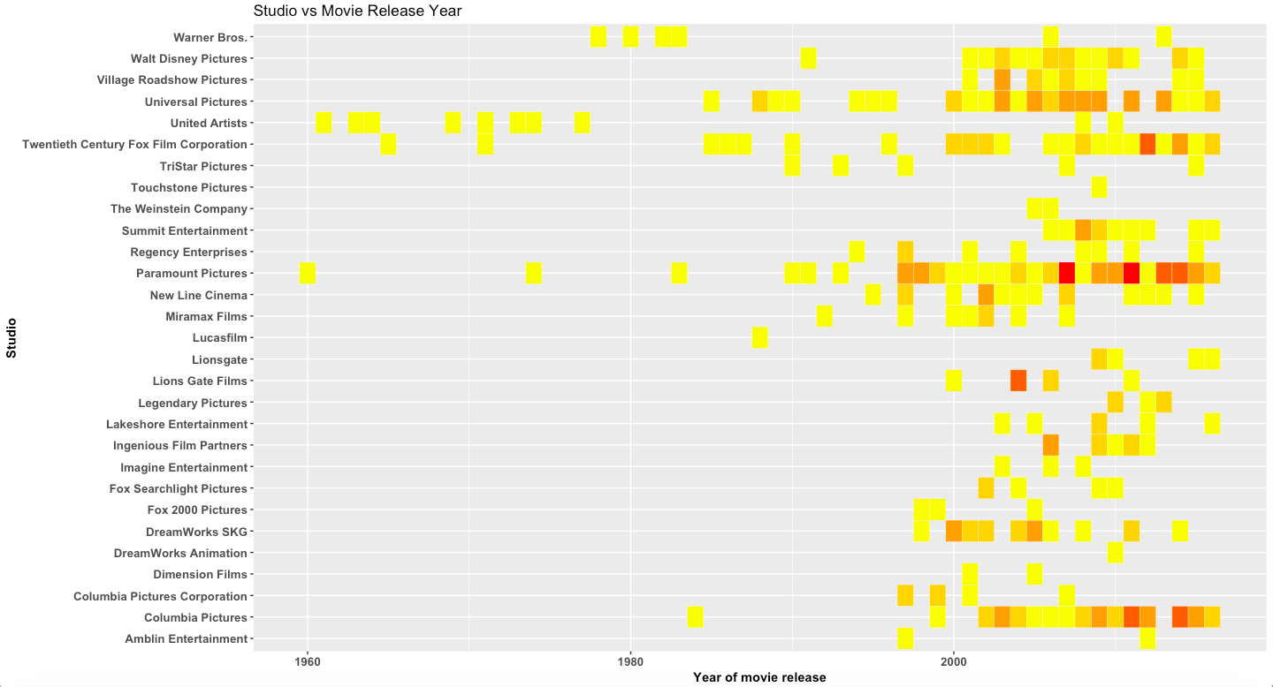
12 Angry Men, Rain Man & Hot Tub Time Machine
Psycho, The Wolf of Wall Street
& Mission Impossible
Inception, The Dark Knight Rises & The Hangover
Notes:
This graph is based on studios which have made at least 10 movies.
From this graph we can see that Paramount pictures was one of the first studios to produce movies in the 1960’s and still is one of the studios that produces the most number of movies.
Columbia Pictures , Universal Pictures and Twentieth Century Fox Studios seem to be the other prominent production houses.
Note – examples for profits, add to PPT

Slide 16
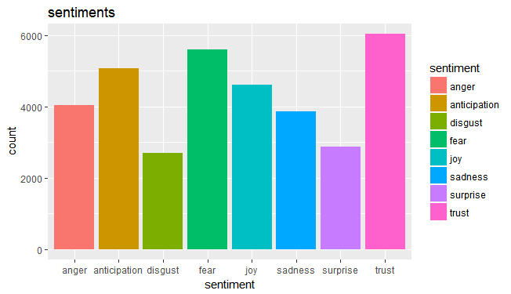
Based on the 'syuzhet' package in R, using the lexicon created by NRC Canada for word-emotion association and analysis
Notes:
This is a sentiment analysis of the movies produced to date using the plot summary for each movie.
Out of the eight emotions represented here, there are a few positive emotions like trust, joy, anticipation and surprise and few negative emotions like fear, disgust, anger, sadness.
As you can see from the graph, two of the topmost emotions are trust and fear – which are two diametrically opposite emotions really.
library used is syuzhet for sentiment analysis.
NRC emotion lexicon (National Research Council of Canada) used in syuzhet package. Word-Emotion association done by crowdsourcing via Amazon Mechanical Turk.
Citation - Ingo Feinerer and Kurt Hornik (2017). tm: Text Mining Package. R package version 0.7-2. https://CRAN.R-project.org/package=tm

Slide 17
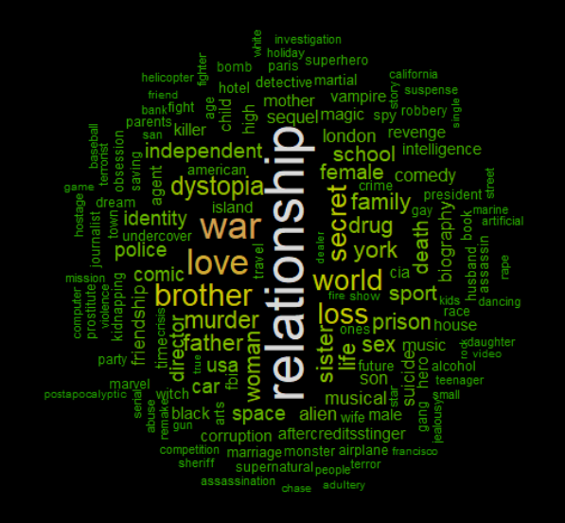
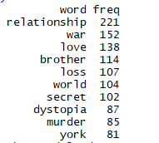
Text Mining using NLP
TOP 10 KEYWORDS
Notes:
After doing a text mining on the keywords used frequently in the movies, we can see that “relationship” occurs most times. Thus we can infer that the ‘trust’ emotion as seen in the sentiment analysis corresponds to this keyword. We also have the keyword “love” coming close behind “relationship”.
We saw that “fear” was a close second in the sentiment analysis – here in the keyword analysis we can see how the keywords “war” can correspond to the emotion of fear. There is also “loss” and “dystopia” in the list which correspond to the negative emotion of fear.

Slide 18
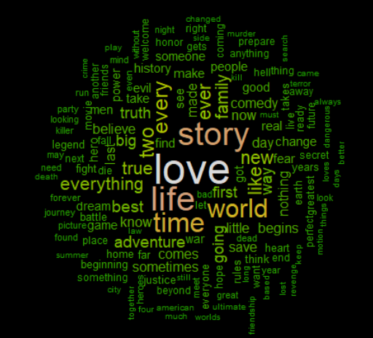
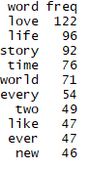
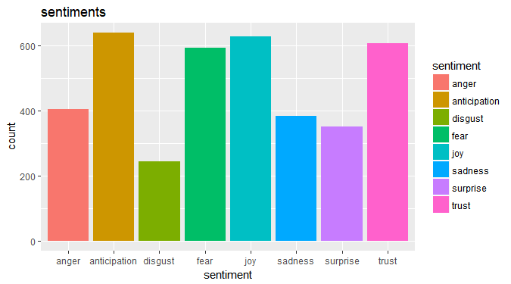
TOP WORDS - TAGLINE
Notes:
We found Trust and Fear, the positive and a negative emotion, in the sentiment analysis. But do the movie makers promote their movies the same way? Are movies that show war, violence, dystopian future, relationship loss promoted as such? Or do producers do positive marketing?
Well, we did a word cloud and sentiment analysis on the most used words in the taglines that are used to promote the movie and appear on posters and billboards.
Not surprisingly, the top emotions represented are the positive ones – joy, anticipation, trust.

Slide 19

APPLICATIONS
Movie theaters nowadays have been facing stiff competition from online movie sources. A theater manager can use this analysis to increase ticket sales or number of shows by investing based on the factors mentioned in our analysis.
On the other hand, a company like Netflix or Hulu can use this analysis to prioritize the purchase of streaming rights. For example they can look at the popularity of an actor on social media or their imdb critic score and decide to invest more in that particular actors' movies.
To interest their users into watching more movies, they can optimize their recommendation engine depending on the genres, social media popularity, actor-director combinations etc.
Notes:
Applications
Netflix – predict which movies to purchase the rights for, depending on actors, genre, social media popularity
Movie theaters can decide on which movies to invest in – show timings, increase number of shows

Slide 20

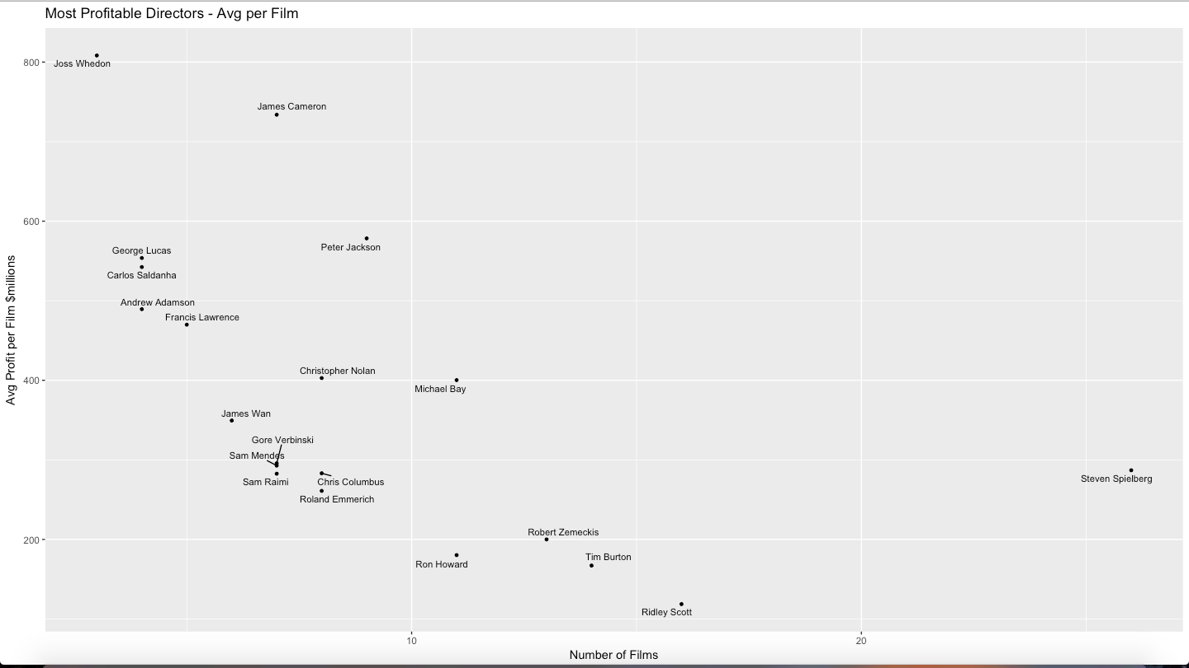
APPENDIX-I : Most profitable directors
Notes:
Change font

Slide 21
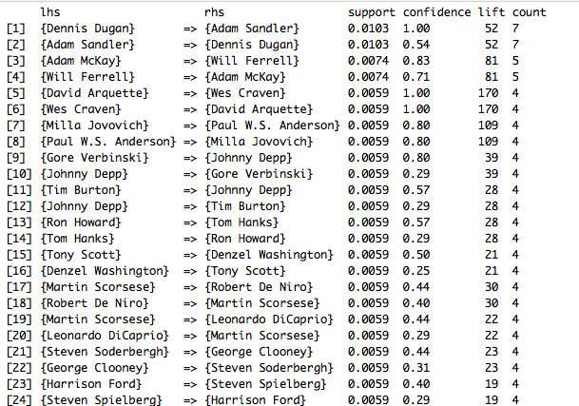
Association Rule Results
APPENDIX-II: Actor-Director combinations

Slide 22
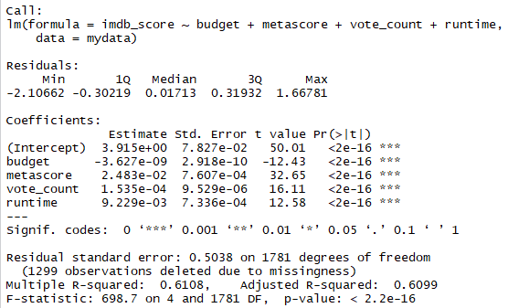
Linear Regression Output for Dependent Variable IMDB_SCORE

